Slide 1


Nolan Pestano at Emerson
Q1->Today
X

Slide 2


Continued Robocorp Maintenance
Rewrote Authentications
  The bots struggled on connecting to MSGraph APIs– I rewrote changes to the way they communicate and log-in to Microsoft.
Bug fixes for the Bots
  All bots are now running independently, with no human input, without errors!
Enabled smoother future updates
  Identified fragile dependencies (UI, file paths, , etc.) and redesigned those parts to be more resilient to change.

Slide 3
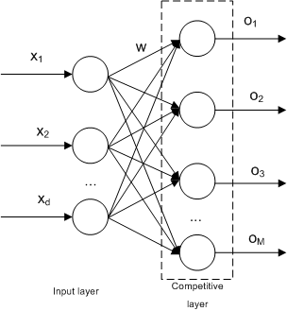
Future-Proofed
Knowledge Transfers
Daily Knowledge Transfers with Fatima/Inti
  Sharing everything I’ve learned over the past year so they can be fast, blazing developers.
Azure DevOps / Documentation
  Built reusable documentation and walkthroughs so future engineers can onboard faster / get acquainted with projects.
Focused on knowledge sharing, not task completion
  Hosting handoff sessions, recording demos, and clearly explaining the why behind technical decisions to make future improvements easier
a neural network

Slide 4

Miscellaneous
Bug Fixes / Quick Wins
CARs Emails (for Kevin Keen)
  Rewrote the .bat and HTTP calls for smoother executions. Runs every Wednesday now without fail!
Batch Scripting for .mcdx (Michelle Knight / MechE team)
  Wrote a shell script to convert their .mcdx Mathdoc files to PDF’s all in one click, saving hours of their time.
OnCall Updates
  Weekly, smart flow featuring persistent memory of our OnCall rotation with accurate notifications.

